Slide 1
Cognitive Behavior Therapy Metaverse Platform Business
18102312 Sangjin Lee
19102079 Kangmin Kim
19102089 Chanwoo Park
19102061 Suho Lee
21102031 Junhyuk Choi
Notes:
Hello we are team []. And this is our business topic: Metaverse Platform Business with Cognitive Behavior Therapy.

Slide 2

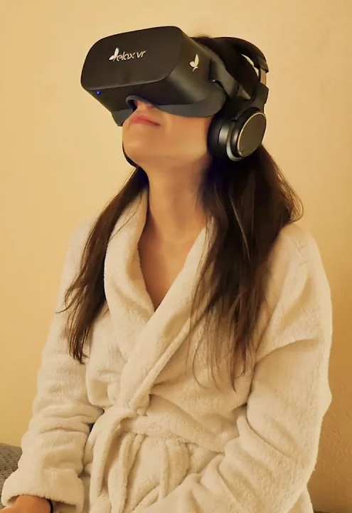
Our Mission and Vision
Mission
1. Improve mental health and well-being through interactive experiences
2. Provide mental health treatment regardless of location or physical abilities.
3. Remove stigmas associated with getting help of mental health treatment and promote
4. Offer evidence-based treatment and personalized care that meets the unique needs of each individual.
Vision
1. A world where mental health treatment is easily available in daily life
2. Innovator in mental health care, exploring new technologies to enhance treatment
3. Deliver immersive and personalized therapeutic experiences
4. Contribute to the mental health research through the collection and analysis of data from our service
Notes:
Here are our business’s Mission and Vision. There are many important things but, most importantly, Our business want to Improve mental health and well-being through interactive experiences as mission, and we are going to make a world where mental health treatment is easily available in daily life as a vision.

Slide 3
Our Goal
1
Ultimate
Provide high-quality cognitive behavioral treatment services that are affordable, convenient, and accessible to individuals worldwide.
2
Long-term
Continually improve and innovate our metaverse-based cognitive behavioral therapy services by incorporating feedback and advancements in technology and therapeutic approaches.
3
Mid-term
leverage the power of the metaverse to create personalized experiences that enhance the effectiveness of cognitive behavioral therapy.
4
Short-term
establish partnerships with mental health professionals and organizations to increase awareness of our metaverse-based services.
Notes:
We divided our goal into 4 stages. Shortly, we will establish partnerships with mental health professionals to increase awareness of our metaverse-based services
In mid term, as the time goes on, we wil leverage the power of the metaverse to create personalized experiences.
Long-term goal is that keep improving of our cognitive behavioral therapy services with user’s feedback.
Ultimately, we will provide high-quality cognitive behavioral treatment that have never existed.

Slide 4
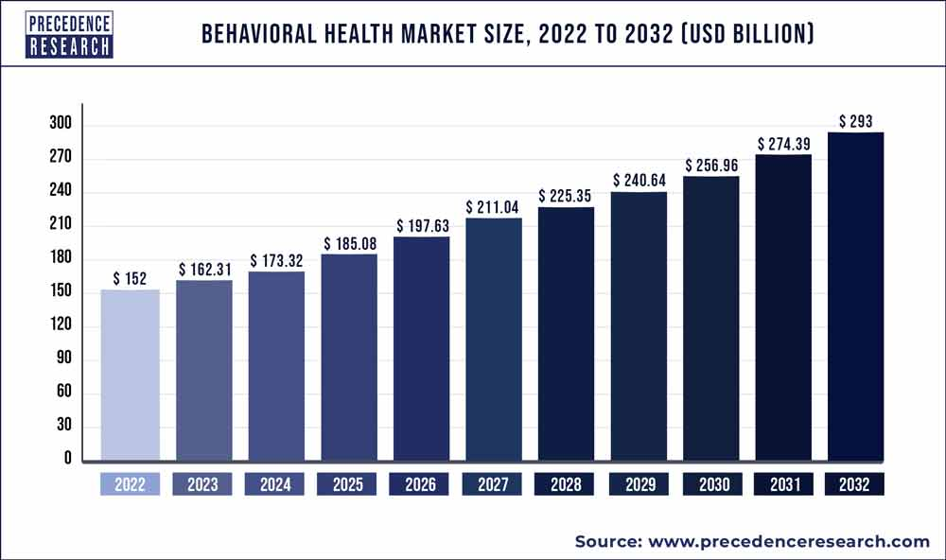
Strategic Analysis – Market
Total Available Market - Mental Health Market
Mental Health Market
Total market size is 182.31 billion dollar, growing at a compound annual growth rate (CAGR) of 6.2% from 2023 to 2030
Digital Mental Health Market
Medical Institutions
Individuals who have mental health issues
Service Available Market - Digital Mental Health Market
USD 2.4 billion and is expected to grow at a CAGR of 25.7% from 2023 to 2030. The increasing adoption of smartphones along with the growing need for remote healthcare services due to the COVID-19, is driving the growth of this market.
Target Market
People mental health issues and are open to exploring new treatment. Also, professionals who are looking for new technologies and offer more effective treatment options.
Notes:
Let’s start analyzing from the market.
Total Available Market (TAM): Mental Health Market
The global mental health market is expected to grow at a CAGR)of 6.2% from 2023 to 2030.
increasing awareness about mental health, the rising prevalence of mental disorders, and the availability of effective treatment options => will be driving the growth of this market.
Service Available Market (SAM): Digital Mental Health Market
This market size was valued at USD 2.4 billion in 2020 and is expected to grow at a CAGR of 25.7% from 2021 to 2028.
The increasing adoption of digital devices along with the growing need for remote healthcare services due to the COVID-19 pandemic => is driving the growth of this market.
Target Market:
Our target market is quite specific. The target market for our service would be
1. professionals who are looking for new treatment for their patients
2. individuals who are seeking remote mental health treatment

Slide 5
Strategic Analysis – SWOT
S
W
Strength
Weakness
1. Wide accessibility
2. Interactive experiences
3. Personalized care
4. Free of stigma problem
1. Technology dependency
2. Limited awareness
O
T
Opportunities
Threats
1. Growing demand
2. Technological
3. advancements
1. Regulation
2. Ethical considerations
Notes:
We conducted SWOT Analysis for our strategy.
First, Strength.
Wide accessibility: the company can reach a global audience, increasing its potential customer base.
Interactive experiences: we focus on interactive experiences => we are apart from traditional treatment approaches, offering a unique value proposition.
Personalized care: By offering evidence-based treatment and personalized care, the company can tailor its services to meet the unique needs of each individual.
Last, since if user can buy product and enjoy the treatment in home, it is free of stigma problem(낙인효과).
Of course, there are weaknesses:
Technology dependency: Relying on new technologies, such as the meta-verse platform, may pose challenges and include technological issues.
Limited awareness: The company may the need to promote its services to reach a wider audience and increase awareness since this type of service is so rare.
Let’s move on to Opportunities:
Growing demand: The increasing recognition of the importance of mental health and well-being presents an opportunity for the company to tap into a rapidly growing market.
Technological advancements: The continuous advancements in technology provide opportunities to explore new technologies and innovative approaches to enhance mental health treatment.
Lastly, Threats:
Regulation: Depending on the company's target markets, it may face regulatory hurdles, such as licensing requirements or compliance with privacy and data protection regulations.
Ethical considerations: As the company collects and analyzes data from its services, it must address potential ethical concerns related to privacy.

Slide 6
Strategic Analysis – 5 Forces Model
High
The mental health treatment market is increasing rapidly
New Entrants Threat
Low
Moderate
High
multiple suppliers or the company can develop its own proprietary technologies
The focus on evidence-based treatment experiences differentiates company
customers have the treatment options
Power of suppliers
Competition in Industry
Power of Customers
High
The acceptance of traditional therapy
Threats of Existing Substitutes
Notes:
Next, We conducted Porter's Five Forces Analysis
We considered Threat of New Entrants as High Because The mental health treatment market is experiencing increasing demand and recognition.
Bargaining Power of customers seems to be also High because customers have the flexibility to choose from a range of providers and treatment options.
Next high ranked one is Threat of Substitutes.
While the company aims to provide unique and interactive experiences, there are alternative approaches to mental health treatment, such as traditional therapy or in-person counseling.
On the other hand, we saw Bargaining Power of Suppliers as Low.
There are likely multiple suppliers available in the market. This will give our business more leverage in negotiating favorable terms and conditions.
The competitive rivalry in the mental health treatment market is relatively low. While the market may be crowded with various providers, the focus on evidence-based treatment, personalized care, and innovative interactive experiences. This allows us to potentially have a competitive advantage and establish a unique position in the market.

Slide 7
Strategic Formulation
Set corporation priorities
The ultimate goal of corporation, “make profit” should be available.
To fuse it with mission and vision, the most important component is Sustainability.
Ensure the long-term viability of our business.
=> allows us to make a positive impact on individuals' mental health while also creating a profitable and sustainable services.
1.
Corporate
Technology-based Service-oriented Business
Position our business as a leader in 1:1 emotionally tailored cognitive behavioral therapy in the metaverse by emphasizing personalized care, AI integration, and immersive experiences. Target women aged 20-40 and Psychiatric Institutions. Forge partnerships, utilize digital marketing, invest in R&D, prioritize ethics and data privacy, and remain adaptable to evolving customer needs and technology.
2.
Business
Notes:
By prioritizing sustainability, we ensure the long-term viability of our business. This approach allows us to make a positive impact on individuals' mental health while also creating a profitable and sustainable services.

Slide 8
Strategic Formulation
HR Strategy
prioritize the growth and engagement of our employees as highest value.
3.
Functional
Financial Strategy
We mainly get invest from VC. The first year will focus primarily on service development and market entry. operating expense 50%, Marketing 20% Research and development 20%. And emergency fund 10%
Marketing Strategy
As our main target is Women between the ages of 20~40. advertise our service use Viral Marketing, using social media with Influencer
4.
Agile project management
=> to ensure iterative and incremental development. Involve customers
in the development process by conducting user testing. Incorporate this feedback into the product backlog and adjust priorities accordingly.
Operational
Notes:
Women between the ages of 20 ~ 40

Slide 9
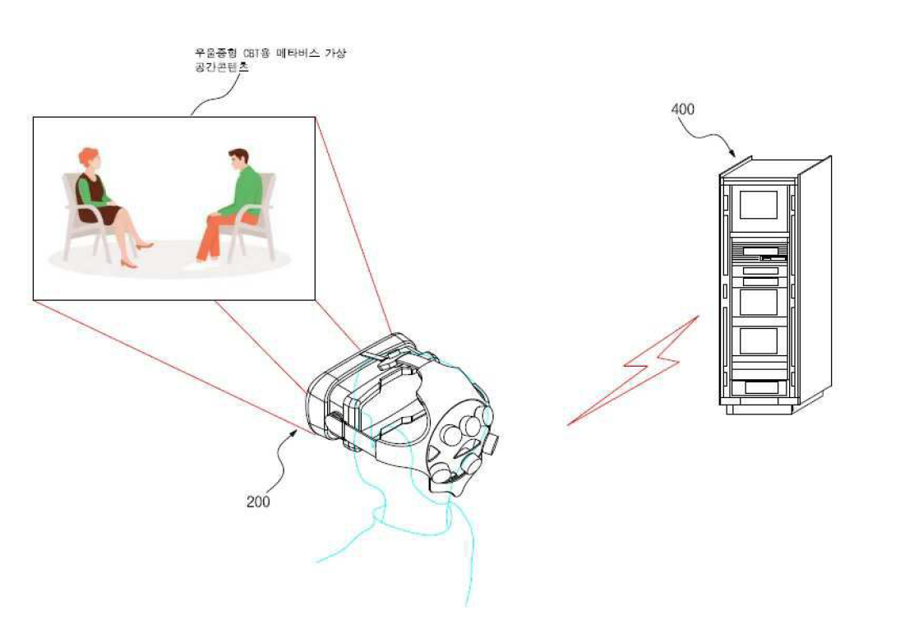
Product Concept
AI Emotion Control Module
Utilizes EEG detection, physiological responses, voice tone, facial expressions, and contextual inputs. It analyzes emotional experiences.
Integration with VR Machines
interacts with the VR machine's tracking systems and sensors, enhancing the user's sense of immersion and realism within the virtual environment.
Emotional Experience Customization
assigns action tasks to user in the metaverse.
aims to change users' perceptions of various emotions in the virtual space.
Notes:
Our service become available with two components: vr and eeg.
We will secure an install base by making the eeg compatible with the vr device called Oculus, which has the highest market share in the current market.
AI Emotion Control Module: Our eeg utilize the detection of physiological and physical responses, voice tone, facial expressions, and contextual inputs. And It analyzes emotional experiences.
2. Integration with VR Machines:
As shown before, our eeg is compatible with VR device called Oculus. So, It can Interact with VR machine's tracking systems and sensors.
3. Emotional Experience Customization
Finally, it assigns action tasks to user in the metaverse.
And it aims to change users' perceptions of various emotions within the virtual space.

Slide 10
Service Concept
Virtual Emotion Therapy Meta-Verse platform
Virtual Emotion Therapy utilizes the power of AI and the immersive meta-verse to help patients manage their emotions.
Our therapy sessions take place in a virtual world where patients experience various emotional scenarios designed to trigger their emotions.
How it works
Benefit
Initial Consultation
Virtual Emotion Scenarios
Immersive Meta-verse Experience
Progress
Tracking
Safe and Controlled Environment
Customized
Therapy
Real-Time
Feedback
Immersive
Therapy
starts with an initial consult where the patient's emotional state is assessed, and their therapy goals are determined.
Based on the patient's goals,
our AI emotion control module creates customized emotional scenarios.
have a sense of presence and can interact with the virtual world.
progress of each patient is tracked, and regular therapy sessions are scheduled to review progress.
Patients can experience a range of emotions in a safe and controlled environment
ensuring that therapy is tailored to the patient's needs.
helping patients learn and practice emotional regulation techniques more effectively
ensuring that therapy goals are met and therapy is effective.
Metaverse
CBT Session
Emotion Analysis
AI-Driven
Contents
Consulting
Notes:
This is our service concept. Since there are complicated mechanism, we summed up like below:
User enters metaverse for therapy session.
Emotions analyzed during metaverse content.
AI-generated content tailored to user's emotions.
Connect with counselor for additional counseling.

Slide 11
Business Model
Key Partners
Key Activities
Value Propositions
Customer Relationships
Customer
Segments
Developing
Metaverse Platform
Licensed
Therapists
Personalized
support
Licensing patent
Personalized
therapy
sessions
Regular
therapy sessions
Medical
Institutions
Partnership
EEG device
providers
Immersive
Environment
Key Resources
Channels
EEG module
Individuals
Online
Medical Institution
Metaverse Platform
Real-time feedback
intermediaries
Cost Structure
Revenue Streams
Meta-verse platform
development costs
Metaverse /
VR rendering Server
Patent on AI
Outsourcing on Ai driven device
Advertisement
Sales on Hardware
SW licensing
Counseling Commission
Notes:
So, this is our Business Model. Rest of components are things we have told or will tell. So, let me introduce some parts.
Our key resource is Metaverse platform and EEG module.
Our EEG Model will be distributed by ~~~

Slide 12
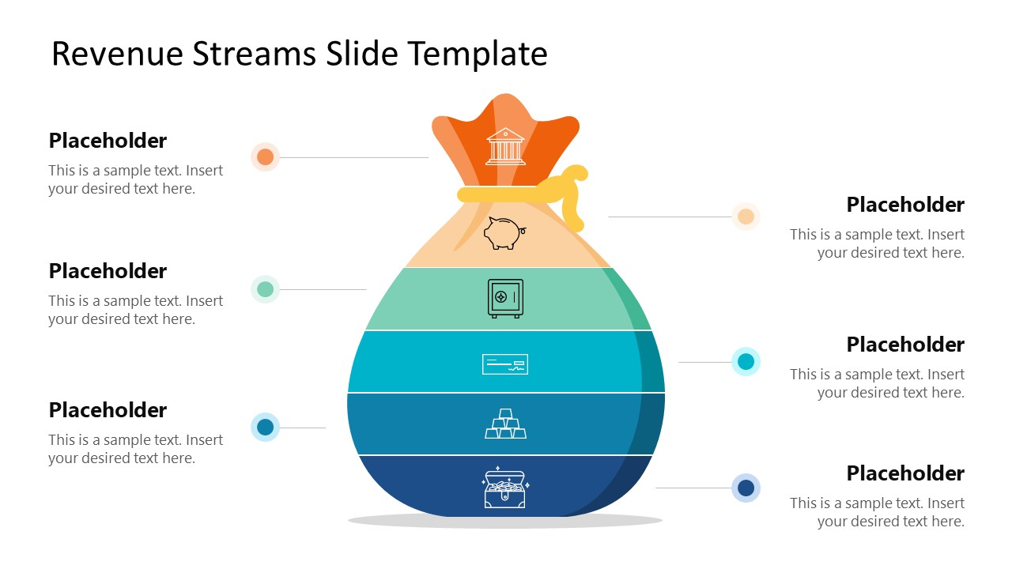
Profit Model
Counseling commissions
In the virtual space
SW licensing for therapy sessions
Advertisement
Sale of EEG module
Notes:
this is how we generate profits.
Charge patients based on their usage of therapy sessions.
In the virtual space, counseling is provided to the patient through a professional counselor, and also commissions.
Collect SW licensing from medical institutions for using our session service.
Advertisement profits in the platform
Sale of EEG module

Slide 13
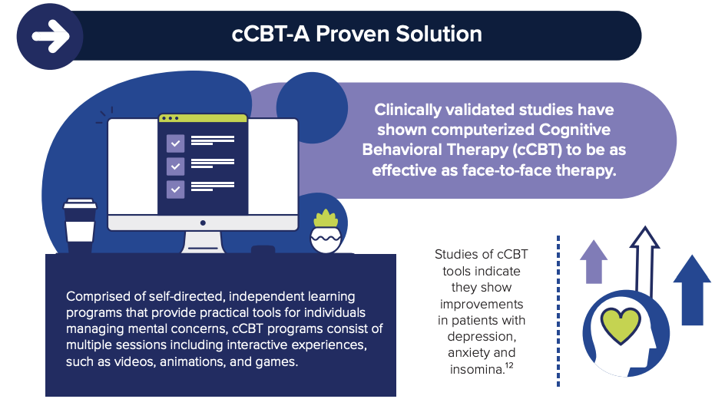
Technology Trend Analysis
AI assumes the role of “therapist”
“computerized CBT,” With AI
Involving a series of online sessions and interactive experiences conducted over a period of weeks.
Like many consumer-driven online services, cCBT uses AI, and interactive algorithms to approximate some of the same back-and-forth exchanges one might expect in face-to-face counseling.
Session
Unestablished Dominant Design
The client is assigned specific “homework” to complete in between sessions.
Some cCBT formats are entirely AI-driven, while others offer the user the option to interact with a live counselor when additional guidance is needed.
Notes:
Let’s move on to Technology Trend Analysis.
CBT was provided almost entirely through face-to-face sessions.
However, increasing number of “computerized CBT,”
Like many consumer-driven online services, cCBT uses AI, and interactive algorithms to approximate face-to-face counseling.
In this sense, AI assumes the role of “therapist.” Most cCBT programs involve a series of online sessions and interactive experiences conducted over a period of weeks.
Some cCBT formats are entirely AI-driven, while others offer the user the option to interact with a live counselor when additional guidance is needed. So, there is no dominant design yet.

Slide 14
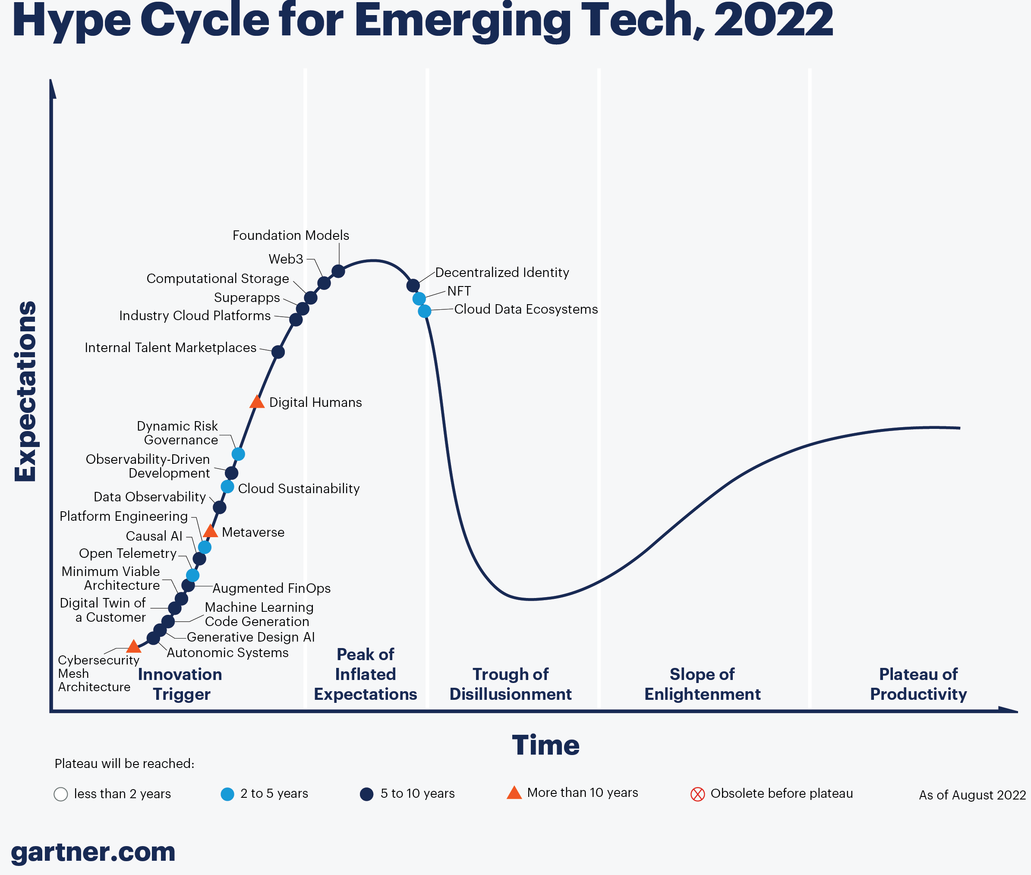
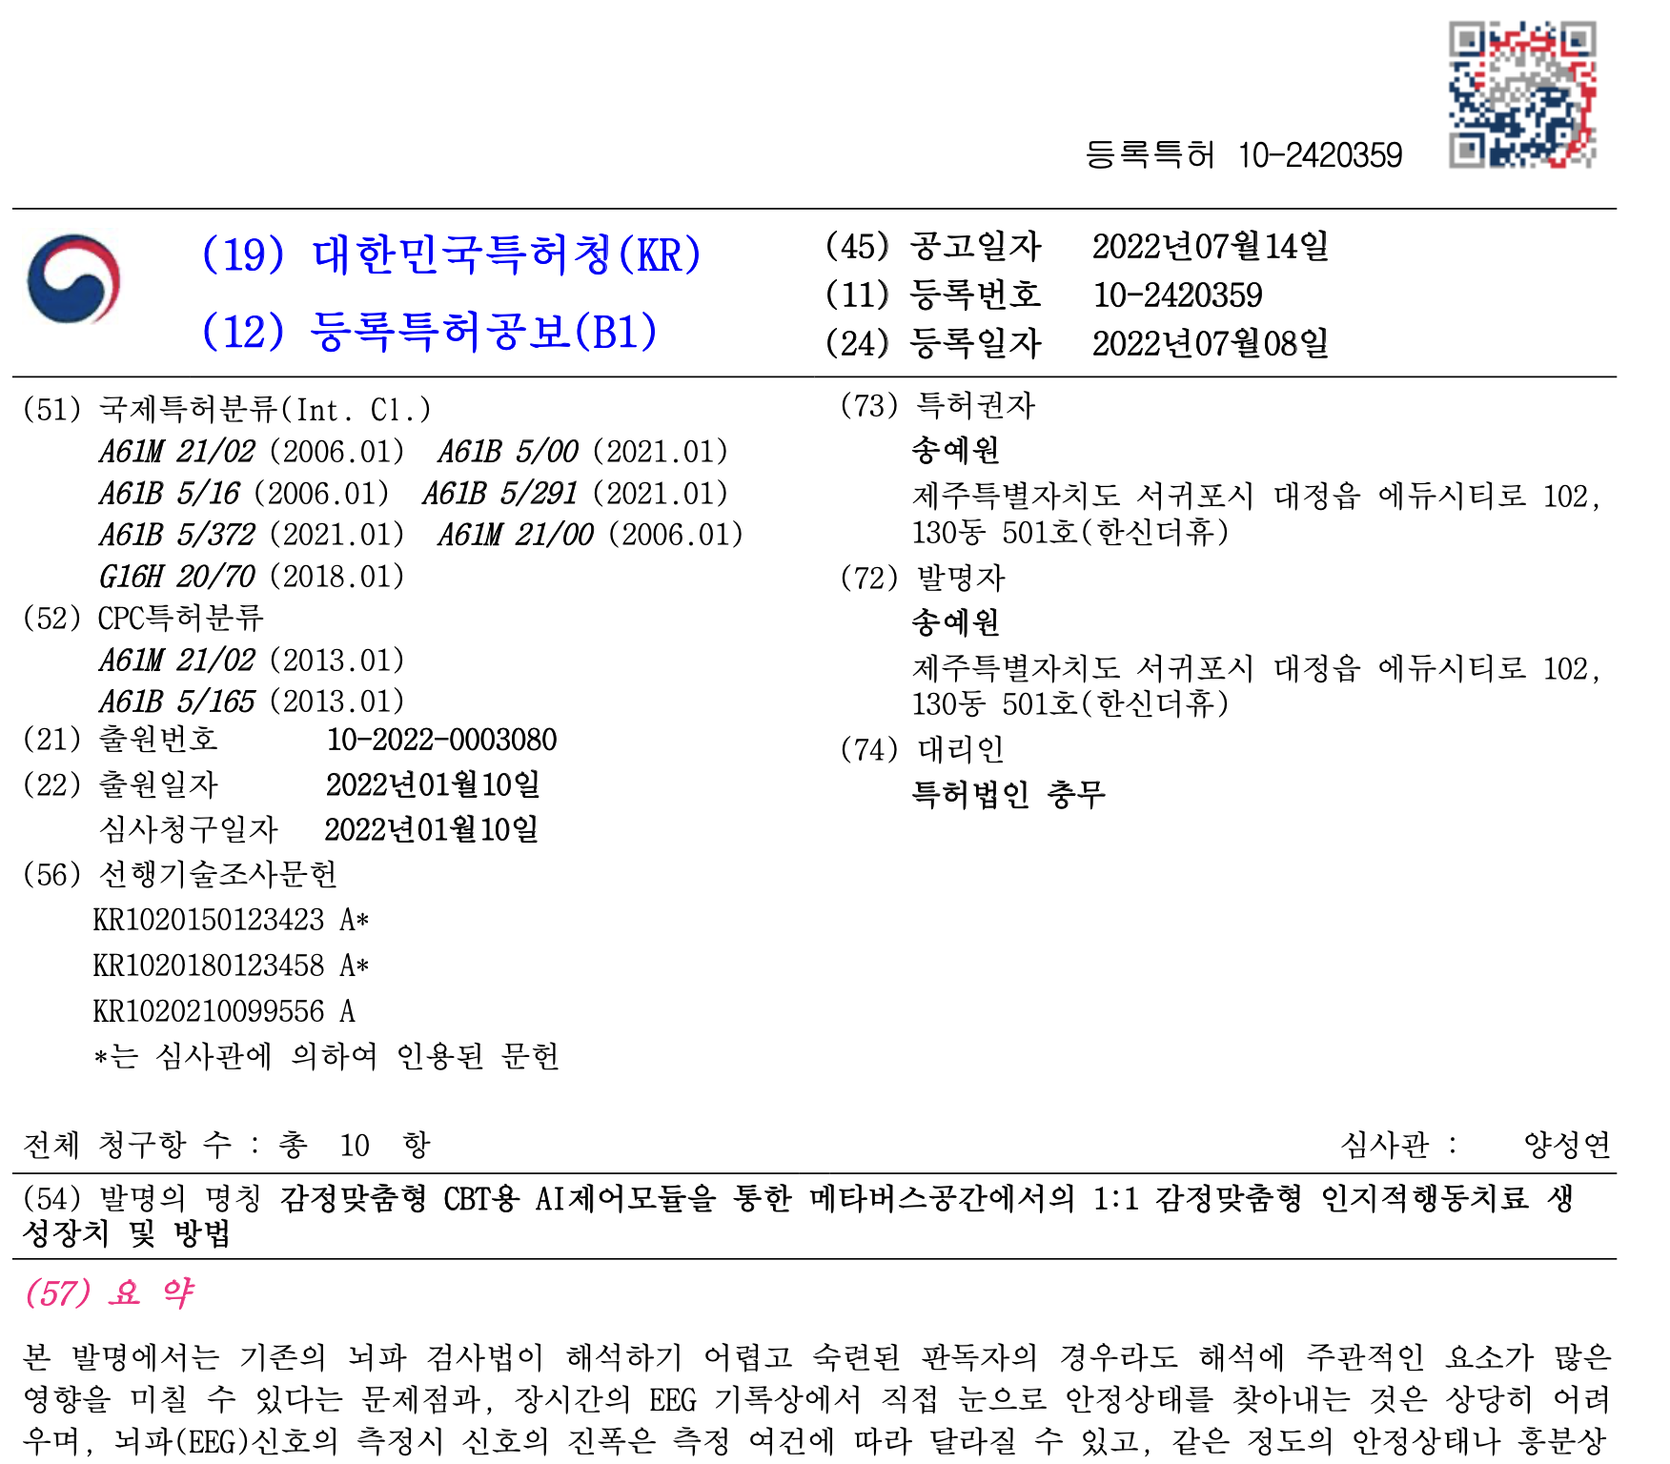
Technology Trend Analysis
We are the First Mover
Interactive cCBT technology using VR and metaverse is not currently on the market and was recently registered as a patent
Notes:
According to the technology cycle published by Gartner, metaverse technology is in its infancy.
Also, as the patent for the technology we use was registered in July 2022, we are the first mover in technology.

Slide 15

Technology Acquisition Plan
Licensing
We want to use a technology that has been patented by someone else to start a business. Therefore, we need to obtain a license from the patent holder. Details of the license agreement are based on the statistics and the characteristics of our company's products and services.
Notes:
Next, let’s find out how we will acquire the technology.
The key part is the way cognitive behavioral therapy works with the software, controlling hardware and interpreting the responses of patients.
We want to use a technology that has been patented by someone else to start a business.
Therefore, we need to obtain a license from the patent holder.
We determined the details of the license agreement based on the statistics of the most recent domestic patent licensing research and the characteristics of our company's products and services.

Slide 16
Technology Acquisition Plan
Non-exclusive licenses (57.5%) exclusive licenses (40.9%)
The more important the exclusive intellectual property strategy is, the higher the proportion of exclusive license agreements
-> Exclusive license
01
Exclusivity
02
Royalties
The average royalty rate was 5.5%
5~10% with 28.2%, followed by 3~5% and less than 3%.
-> Running Royalty 5% of total sales of contracted products
03
Term
In the case of an exclusive license, the proportion of contracts based on the duration of the patent is 55%, higher than non-exclusive license
-> Contract based on the duration of the patent
04
Types of License
Single patent licenses accounted for 86% of the total, Rather than Package licenses
-> Single License
Notes:
First consideration is exclusivity. Non-exclusive licenses accounted for the highest share (57.5%) in the statistics. And In the case where exclusive IP strategies are important, the proportion of exclusive license contracts is high, so we will also contract with an exclusive license.
The average royalty rate was 5.5% - 5~10% with 28.2%, followed by 3~5% and less than 3%. So, We will contract with running royalty 5% of total sales for the contracted product.
In the case of an exclusive license, the proportion of contracts based on the duration of the patent is 55% which is majority.
Also, In the case of medical, pharmaceutical, and chemical technologies, the proportion of contracts based on the duration of patent rights very high at 86.7%, 77.8%, and 61.8%
So we decided to contract based on the duration of patent.
As for the types of license agreements, single patent licenses accounted for 86% of the total. The patent holder does not have any additional technology other than the patent our company is targeting. And the remaining technologies were judged to be services that our company could implement on its own.

Slide 17
Technology Acquisition Plan
2023
2024
2025
Year0
Year1
Year2
Assess the feasibility of technology
Finalize licensing agreements and negotiations with partners
Create a budget for technology acquisition
Develop and integrate acquired technology into the company’s service
Finalize implementation of acquired technology
Monitor progress and make adjustments Conduct regular evaluations of the effectiveness of acquired technology
2026
2027
Year3
Year4
Evaluate the success of acquired technology Consider potential additional acquisitions
Continuously assess the company's technology needs and identify areas for improvement
Continue to monitor and evaluate the effectiveness of acquired technology
Develop plans for future technology acquisition and integration
Notes:
This is the timeline for our technology acquisition plan.
Year0: Feasibility assessment, licensing agreements, budget creation for technology acquisition.
Year1: Development and integration of acquired technology into company's services.
Year2: Finalize implementation, monitor progress, make adjustments, evaluate effectiveness.
Year3: Evaluate success, consider additional acquisitions, assess technology needs and improvements.
Year4: Monitor and evaluate effectiveness, develop plans for future technology acquisition and integration.

Slide 18

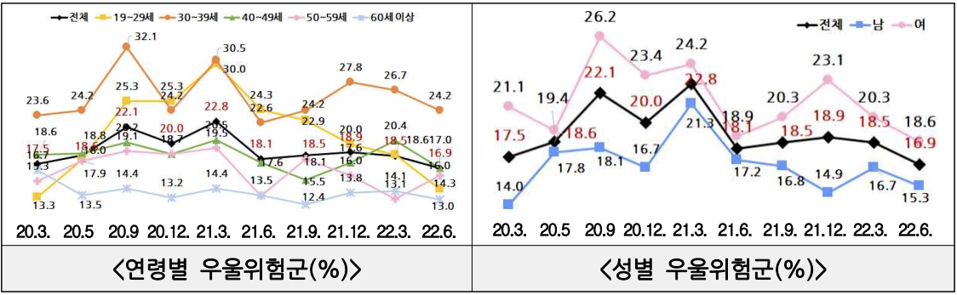
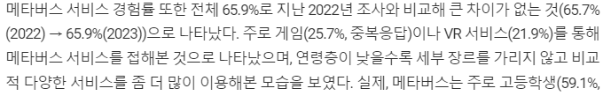
STP Analysis
02
Targeting
01
Segmentation
Individuals looking for CBT(Cognitive Behavior Therapy)
Individuals who are familiar with metaverse environment
Students
Medical institutions
Mental health clinics in Regions with Many Single-Female Households
Women between the ages of 20 ~ 40 living
Notes:
This is STP Analysis part.
Here, first, based on the characteristics of our business, we have divided our clients into several segment as Individuals looking for CBT, Individuals who are familiar with metaverse environment, Students, and Medical institutions.
Additionally, we specified target customer of our business.
According to the statistics from the Ministry of Health and Welfare in 2022, People between the ages of 19 and 39 have the highest risk for depression, and the risk group for depression by gender is also higher in women than in men. Also, the younger the person, the more likely they are to be open-minded to new technologies such as the metaverse or AI. In addition, thanks to the benefits of Metaverse technology, our products and services can be used even in areas with poor health facilities. So, we targeted women between age of 20 to 40 living in rural area.

Slide 19
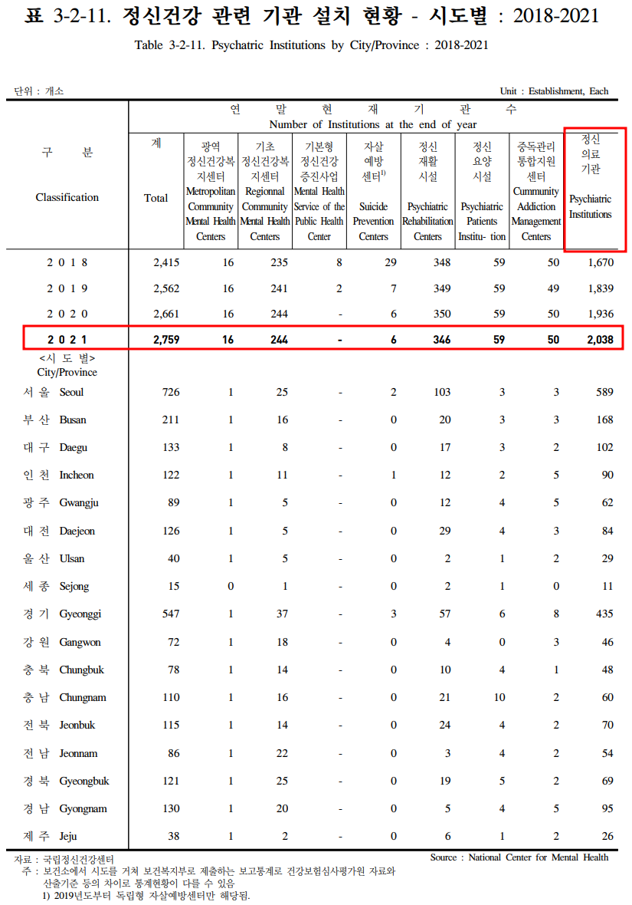
STP Analysis
Why do we choose Psychiatric Institutions as Main target?
They are located in various regions. Also, they has the most large number of branches.
Notes:
The reason why we choose Psychiatric Institutions as Main target is that according to the 2022 Health and Welfare Statistical Yearbook from the Ministry of Health and Welfare, they are located in various regions. Also, they has the most large number of branches among the mental health institutions.

Slide 20
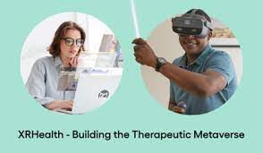
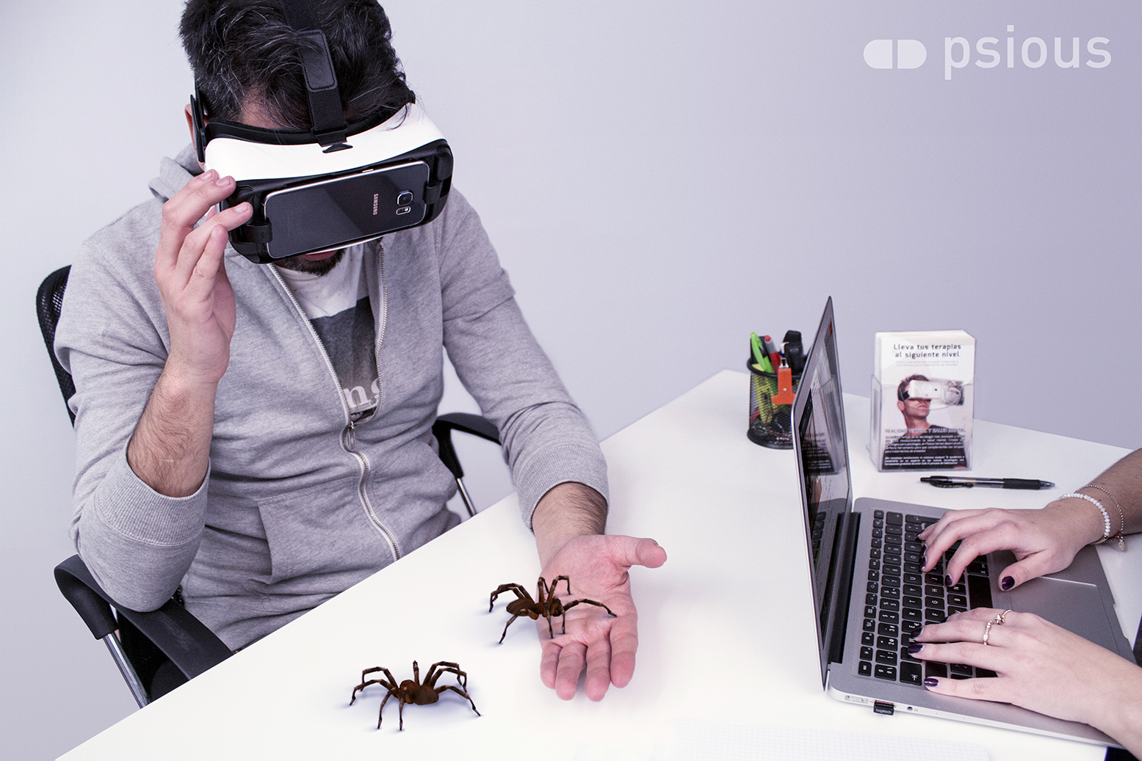
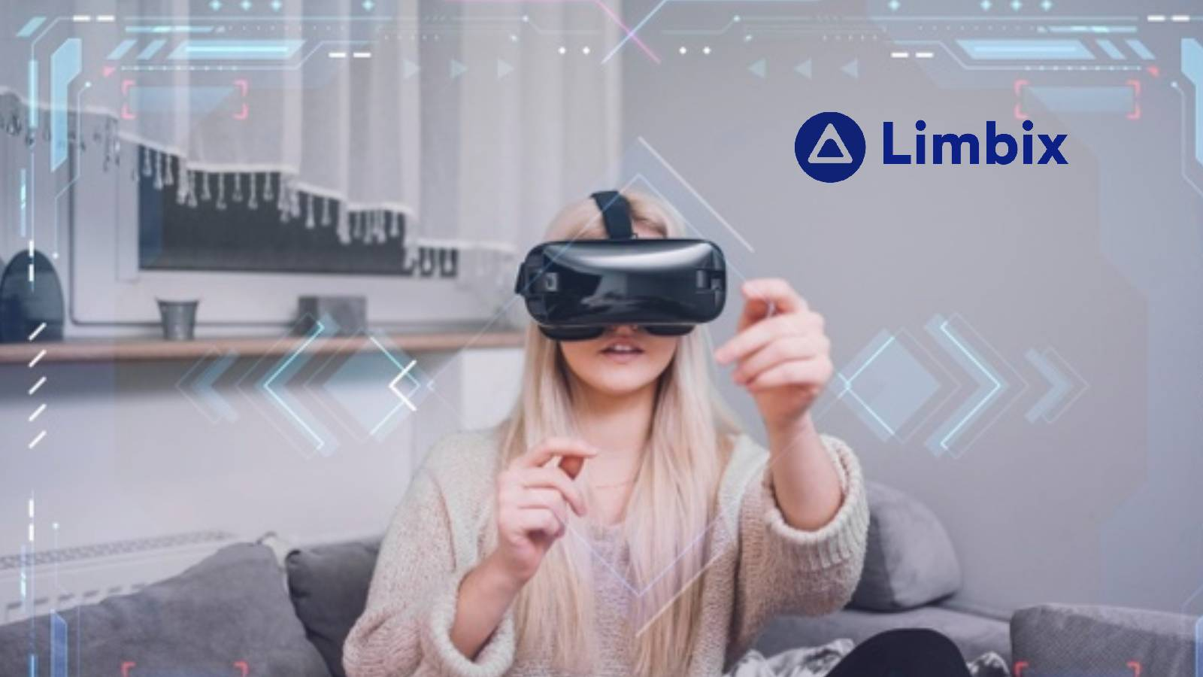
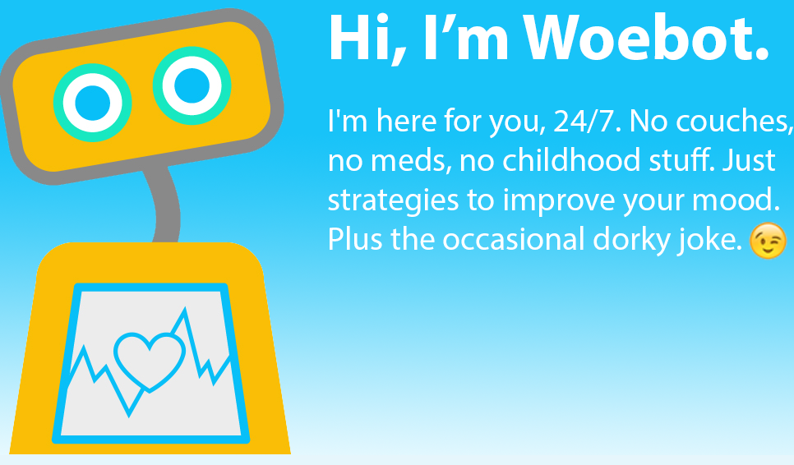
STP Analysis
Customized
Our Business
03
Positioning
XRHealth
Provide personalized therapy contents which result in enhanced effectiveness.
Foster engagement, motivation, and behaviors creating satisfactory user experience. .
Interactive
Limbix
psious
Woebot
Notes:
This is positioning part for our business.
We compared mental health companies with our business.
Our business provides personalized therapy contents which result in enhanced effectiveness and fosters engagement, motivation, and behaviors creating satisfactory user experience.
So, our business is positioned like this.

Slide 21
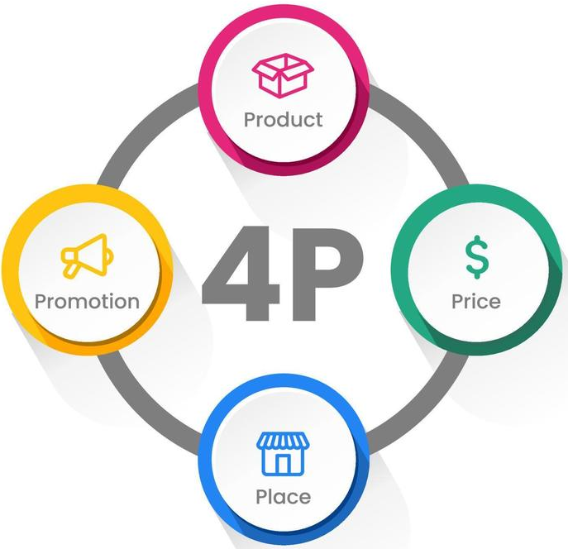
4p Marketing
Product
AI-driven therapy device that provides 1:1 emotionally tailored cognitive behavioral therapy (CBT) through a metaverse space.
Promotion
Price
Social Media Advertising
Influencer Marketing
TV Advertising
$799
Place
Web-site
Social Media
Metaverse Communities
Online Market Places
Notes:
Product here is about what is it that we sell, and how does it fulfill our customers’ needs.
Our AI-driven therapy device can provide a personalized, convenient, and effective therapy experience for women who are open-minded about metaverse and AI technology and are seeking personalized therapy that fits their busy lifestyle.
Place here is about where do we promote or sell our product.
We can promote our product and provide information on the features, benefits, and pricing of our AI-driven therapy device. For example, we can offer online demos or trial versions of the product through our website.
Social media platforms such as Facebook, Instagram, and Twitter can be effective channels to promote our product and reach our target market. For example, we can create social media profiles for our business and post engaging content that highlights the benefits of our product.
As our target market is open-minded about metaverse technology, we can target metaverse communities on platforms. Especially, we can participate in these communities, create our virtual office, and offer virtual demos of our AI-driven therapy device.
Also, we can sell our AI-driven therapy device on online marketplaces such as Amazon, Etsy, and eBay. These platforms allow us to reach a large customer base and can help increase sales.
Price here is about how much is your product.
We could offer different pricing tiers that provide access to different levels of therapy sessions or features. For example, we can offer a basic package that includes a limited number of therapy sessions per month, and a premium package that includes unlimited sessions and additional features like real-time monitoring of emotional state.
Promotion here is about how do our ideal customers find out about us.
We can run paid advertising campaigns on social media platforms. These platforms offer highly targeted advertising options that allow us to reach our ideal customers based on demographics, interests, and behaviors.
Partnering with influencers in the mental health or technology space can help increase brand awareness among our target market. Influencers can promote our product to their followers through their social media profiles, blog posts, and other digital channels.
Also, we can run TV advertising campaigns on channels that cater to our target market. For example, we can advertise on channels that air shows related to mental health, technology, or the metaverse space.

Slide 22
Organization Structure
CEO : Junhyuk
Project Manager : Kangmin
Marketing & Customer
Management
Finance & HR Management
Technology
Tax assistant : Chanwoo
Ads Assistance Suho
Technology Reader : Sangjin
Oursourcing || Later
Legal Advisor
Virtual Reality Expert
Medical
Advisor
Notes:
Because we starting a business with limited initial capital, our plan s to form a small team initially and gradually expand the organization size as needed, based on market response and investment potential. To save money, each of us will take on multiple roles instead of having a dedicated role.
Firstly, we have appointed a CEO who will make strategic decisions, lead the team, and attract investments. We also have a project manager who will oversee product development and project management. Below them, we have divided the roles into three areas where a greater need for personnel needed: technology, customer management & marketing and Finance &HR manager. Each area will have three ,two and one members, respectively.
Since the business is in its early stages, we don't anticipate a significant need for personnel in Finance and HR. Therefore, one of us will take on that responsibilities.
Next, there are certain areas that we believe are necessary but hiring full-time employees might be burdensome for the company. In such cases, we plan to enter into contracts to utilize external expertise. For example, we will seek advice from a psychiatrist for mental well-being, considering its relevance to our business. We will also consult professionals regarding legal issues related to personal data and any other legal matters that may arise. Additionally, when creating the initial virtual reality environment, we intend to talk with the virtual reality expert.

Slide 23
Organization Structure
CEO
Project Manager
Marketing & Customer
Management TEAM
Technology
Team
Mental Health
Team
Finance & HR Manager
Ads Assistance
Technology Reader
Psycologists
Tax assistant
Machine learning Engineers
Digital Marketing Expert
EEG Expert
Accountants
Customer service Expert
Data scientists
HR Manager
System administrators
Performance management Expert
Customer Relationship Expert
Legal Expert
UI/UX Designer
Data Analysist
Security Expert
Notes:
This is an organization plan in the future. As the company develops, there will be additional tasks that we should do. So, we will hire employees and divide departments like this figure.

Slide 24
Organization Plan
market research
Branding
Advertisement Promotion
Customer service
Marketing &Customer
Product development
data analysis and Virtual reality development
build system security
product testing
quality control
Technology
budget planning and management
cost management and reduction
Recruitment
training and development
performance management
Finance & HR
Notes:
Start-up companies: Since it is the first time starting a business, it is a start-up type. Startups are flexible in their initial organization and are capable of quick decision-making and execution. We can pursue new ideas and innovative approaches, and are suitable for quick market response and organizational change.
We will talk about what our each of the divided teams will do.
First Marketing&customer management team will do market research, Branding, Advertisement and Promotion, Customer service. An effective marketing and customer management strategy will ensure that our services reach the market appropriately, earn customer trust and loyalty, and continue to grow.
Second Technology team will do Product development, data analysis and Virtual reality development, build system security, and product testing and quality control. The technology team plays a critical role in creating and maintaining the company's core service, the metaverse-based mental health treatment services.
Finally finance and HR team do budget planning and management, cost management and reduction, recruitment, training and development, performance management The finance and human resources teams play a critical role in maintaining the company's financial stability and improving the competence and satisfaction of the team. This is essential for long-term success.

Slide 25
Startup funding
Seed Funding
2023
Expected $224,483.69
Boot Strapping,
Venture capitalists, Crowdfunding
Series A
2025
Expected $748,390.96
Venture Capitalists
Incubators
GRI
Strategic Investors
Series B
2029
Venture Capitalists
Private Equity Firms
Hedge Funds
2030
IPO
Notes:
From now on, I will explain about the financial plan. Based on our business plan introduced earlier, our startup funding is expected to be as follows. It referred to the case of a digital healthcare business called Teladoc. Upon investigation, there was a different stages in start-up funding. It is divided into seed funding, series A and B, according to the investment timing and investment scale of each start-up funding. 2023 is the stage of setting up all business plans in more.
It was judged that about 200 million dollars could be invested, which is same as 3억won. At that time, there are bootstrapping, venture capitalists in the channels that can be invested. Two years later, in 2025 when the service is launched, it will be able to receive about three times than seed funding. In 2029, the year when the business returns to the black, it will once again be able to receive. We aim to issue an IPO in the year 2030 when income becomes a surplus.
It is expected to increase the size of the company. For example, it could be possible to expanding the new digital healthcare business with the capital at that time. From start to finish, business investments can be received from the following corporations and institutes.
But among them, we are going to focus on venture capitalists, which is corporation expected to be fund
In largest scale and be most stable.

Slide 26



Proper VC
2023
2025
2029
2030
Seed Funding
Series A
Series B
IPO
VC who have high tendency to invest in seed funding stage
They usually invest in software, services
They invested in Teladoc in early stage in 2008
F Prime is a capital that specializes in investing in medical health care. And it is very suitable to be invested in a company because it regularly invests in it.
Sequoia capital is one of the most vc fund which has a long-term investment perspective They would give consultant and fix on financing
Notes:
We looked into which VCs can be invested and which VCs should be promoted. In seed funding, it was judged that "trident capital” was appropriate. They have a history of investing the aforementioned 200 million dollar in Teladoc's seed funding. They have tendency to invest in small scale in the early days of software services, and recently portfolio has included a large number of digital healthcare companies. After that, the following corporations are highly expected to invest.
F,prime is judged to have been specialized in healthcare investment. And the scale is 500-1000 million dollars It would be very attractive to each other.
Sequoia have the characteristics of continuous investment in longterm to start-ups.
And when it comes to financing, they provide consultant service. It will be a great help to our business, and make us stable on operating business.

Slide 27
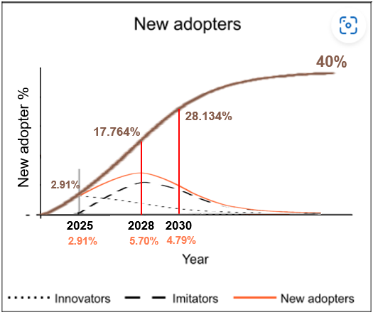
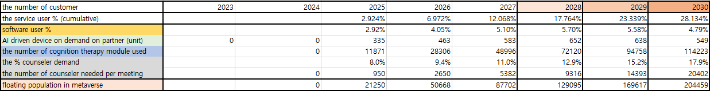
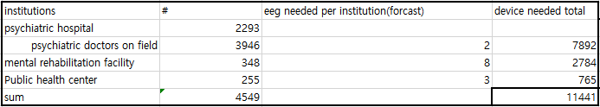
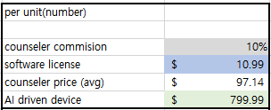
Income Statement
To forecast annual revenue and cost,
estimated some indexes!
Use diffusion model
To forecast user proposition
Research total institutions which are
proper to adopt our products
to forecast the number of AI driven device demand annually
Setting the price of
AI driven device (eeg module)
Software license (cognition therapy)
Matching commission percentage
Notes:
When forecasting gains and losses for about seven years, it is essential to predict the expected number of customers each year. Therefore, we used s-curve to calculate this. To use this, you need to set the coefficients that fit the equation of the graph It was used as a weighted average by examining the coefficients of the metaverse market and the digital healthcare market. And we saved % of users over the next seven years with our potential maximum use percentage at 40%. And sales of ai driven device also used the above s-curve figures. At this time, the potent max use unit was appropriately calculated according to the number of institutions related to cognitive therapy across the country.
We also set the price per unit.
In term of device, we set it 799.99 dollar.
According to the patent, we need multi-channel eeg device, and the price of appropriate product on aim of us was $799.99
And we also set average of counseling price in market with $97

Slide 28
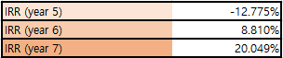
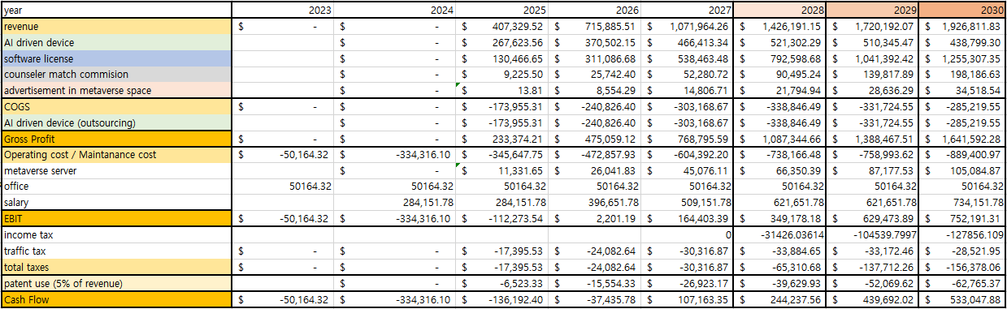
Income Statement
1
Get margin 25% on AI driven device
2
$10.99 software license
per one time
3
10% commission
on psychological counseling per match
4
advertisements on metaverse plaform space
From Profit, substract cost , taxes and legacy fee
Finally, with annual cashflow, calculatre IRR.
Notes:
This is our final income statement
We’ll explain the revenues from several profit models we explain before.
First, we get margin on AI driven device. By outsource device and resale this with 25% higher price.
We multiplied margin per unit and expected number to be solen in each year.
Second, we decided $10.99 to receive from institute when one user use our cognition therapy.
Also multiplying this with expected user, we get the expected profit for this.
We can see this profit model is the most important for us to gain revenue.
Third we get 10% commission per match between counseler and customer.
We calculated expected percentage of user who are going to have counseling among the user of ai therapy.
Lastly, we could expect the advertisement revenue on our metaverse platform.
We expected and calculated the number of floating population on our platform and (expected earnings per person)
and multiplied that.
We also considered the costs, taxes, and patent fee.
And then we could watch final result.
At first, there's a loss of million of dollars in initial years, but It recorded first surplus in 2027, and in 2028 we finally get overall IRR in positive.

Slide 29
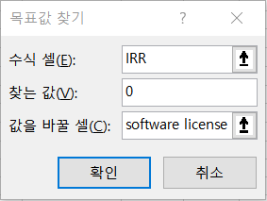
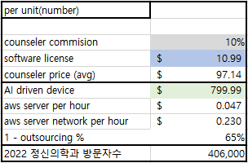
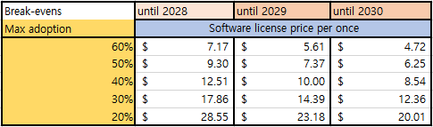
Break-even analysis
Break-even year was 2029(year 6)
Break-even price of software license is $10.00
Which means $10.99 is enough to make IRR positive until 2029.
Notes:
And finally, we proceeded with break-even analysis. As we saw earlier, the product that brings us major profits comes from the software license. Therefore, by changing the software license price, we determined at what amount the margin was zero in a particular year. In addition to this, we calculated the value for other max adaptations. Max adoption is a figure necessary to obtain a user's percentage. However, the predicted user's percentage has a great influence on the previous profit and loss calculation. With this analysis, we can predict the appropriate line of software license price according to our financial purpose. We have plans to receive the first series a funding in 2029. If so, at least at that point, it should appeal to vcs by making the entire IRR positive. The amount at that time is 10.00 dollars and is not far from the 10.99 we set

Slide 30
References
https://www.empathia.com/the-rising-trend-of-computerized-cognitive-behavioral-therapy/
https://www.gartner.com/en/articles/what-s-new-in-the-2022-gartner-hype-cycle-for-emerging-technologies
https://www.data.go.kr/data/15048610/fileData.do
https://www.precedenceresearch.com/behavioral-health-market
https://www.investopedia.com/articles/personal-finance/102015/series-b-c-funding-what-it-all-means-and-how-it-works.asp
https://www.tridentcap.com/portfolio/
https://imotions.com/blog/learning/product-guides/eeg-headset-prices/
https://www.sciencedirect.com/science/article/pii/S1098301518301955#t0005
https://www.sciencedirect.com/science/article/pii/S1098301518301955#t0005
https://www.crunchbase.com/organization/teladoc/company_financials
http://www.riss.kr/search/detail/DetailView.do?p_mat_type=be54d9b8bc7cdb09&control_no=802a12cb18309fe1ffe0bdc3ef48d419&outLink=K
http://www.mohw.go.kr/upload/viewer/skin/doc.html?fn=1641812737137_20220110200537.hwp&rs=/upload/viewer/result/202305/
https://aucshow.com/product/detail/2514402?product_id=240
http://www.newstap.co.kr/news/articleView.html?idxno=147862
https://www.precedenceresearch.com/mental-health-apps-market
https://blog.naver.com/0811gto/222719474494
https://www.precedenceresearch.com/brain-monitoring-devices-market
https://opendata.hira.or.kr/op/opc/selectOpenData.do?sno=11925&publDataTpCd=&searchCnd=&searchWrd=%EB%B3%91%EC%9B%90&pageIndex=2
https://www.doctorsnews.co.kr/news/articleView.html?idxno=130518
https://namu.wiki/w/%EB%B2%95%EC%9D%B8%EC%84%B8

Slide 31
Thank You!

